Slide 2
♦Overview of Company
♦Core Products
♦Cooperative Partners

Slide 3
Overview of Company
Established in 1994, Liansu Machinery is a high-tech enterprise that integrates R&D, production, sales, and service in the manufacturing of plastic extrusion equipment and automation supporting equipment. The company currently has 450 people and its products are mainly sold to domestic and overseas markets such as Asia, Eastern Europe, the Middle East, Africa, and South America. Up to now, it has been exported to about 100 countries and regions. Over the past five years, the performance of exports and domestic business accounts for about half each.
At present, the R&D team of Liansu Machinery has a total of 60 technical engineers and owns a total of 195 processing equipment, including over 20 CNC machining centers. The annual production capacity is about 300 production lines of extrusion equipment, about 60 sets of feeding systems, and about 1500 permanent magnet servo motors.

Slide 4
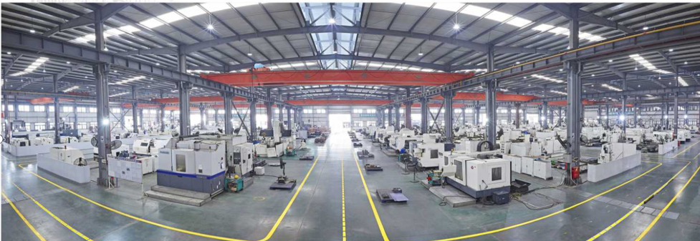
Processing Workshop

Slide 5
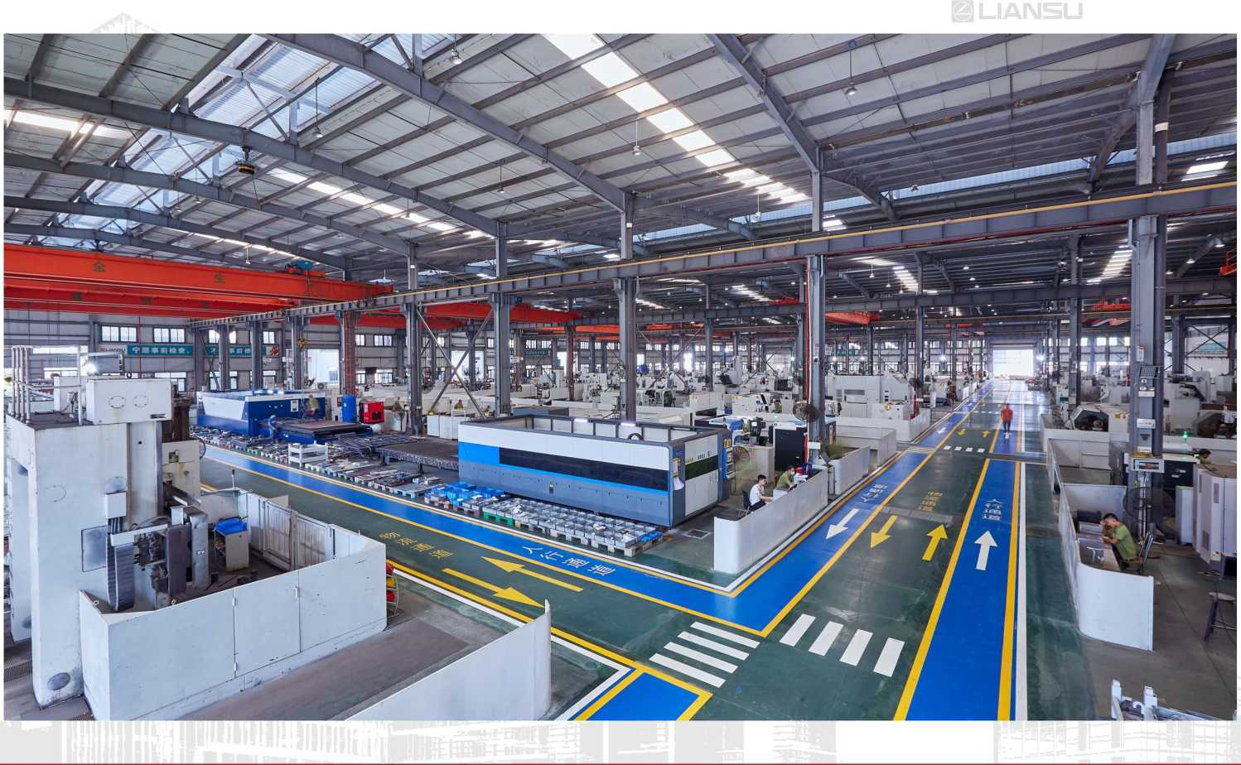
Processing Workshop

Slide 6
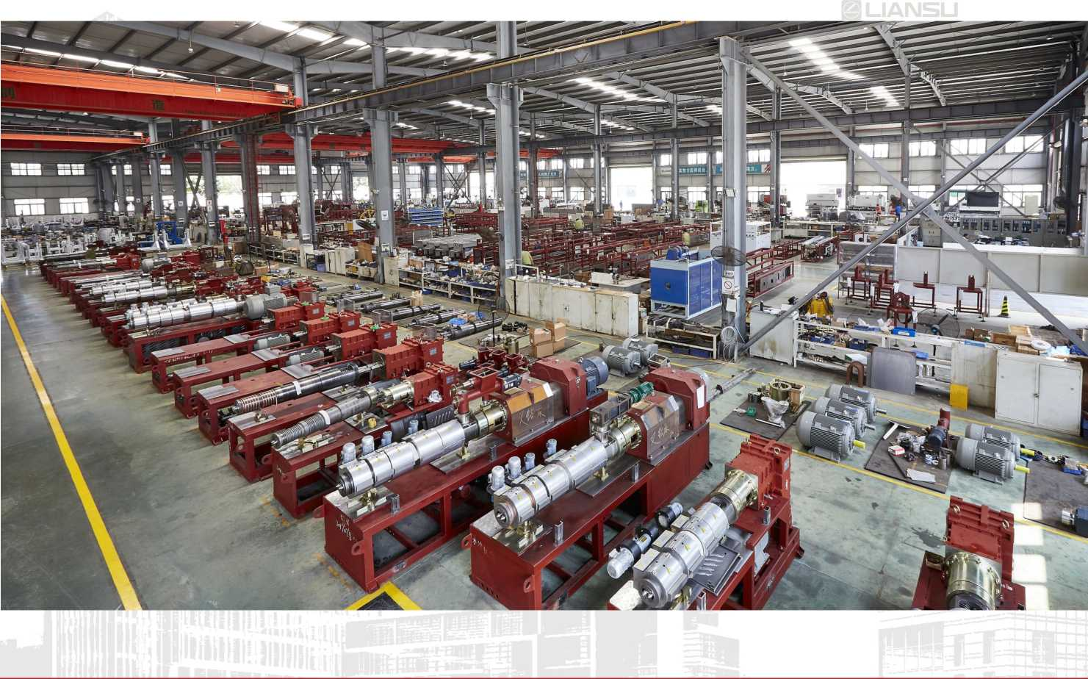
Installation Workshop

Slide 7
Installation Workshop

Slide 8
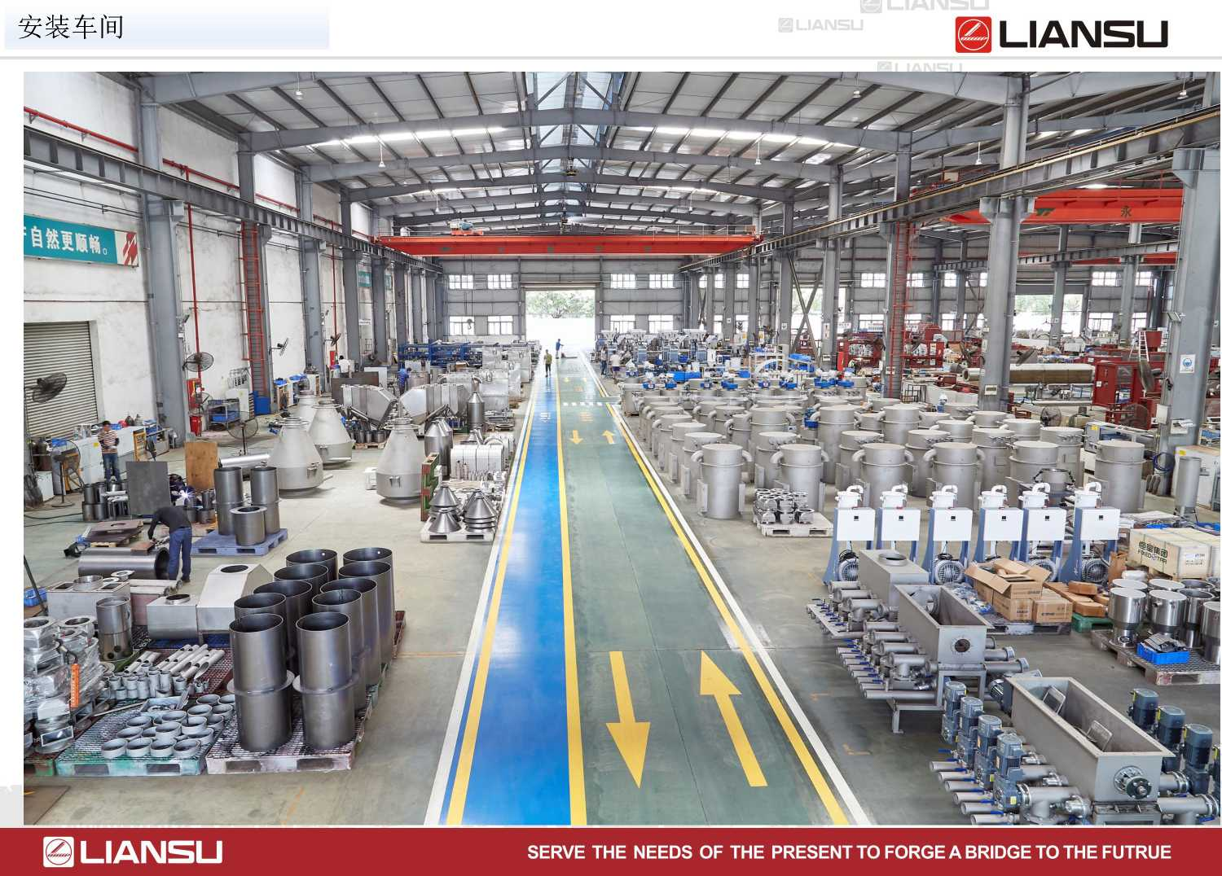
产品优势介绍--HDPE管材设备
Installation Workshop

Slide 9
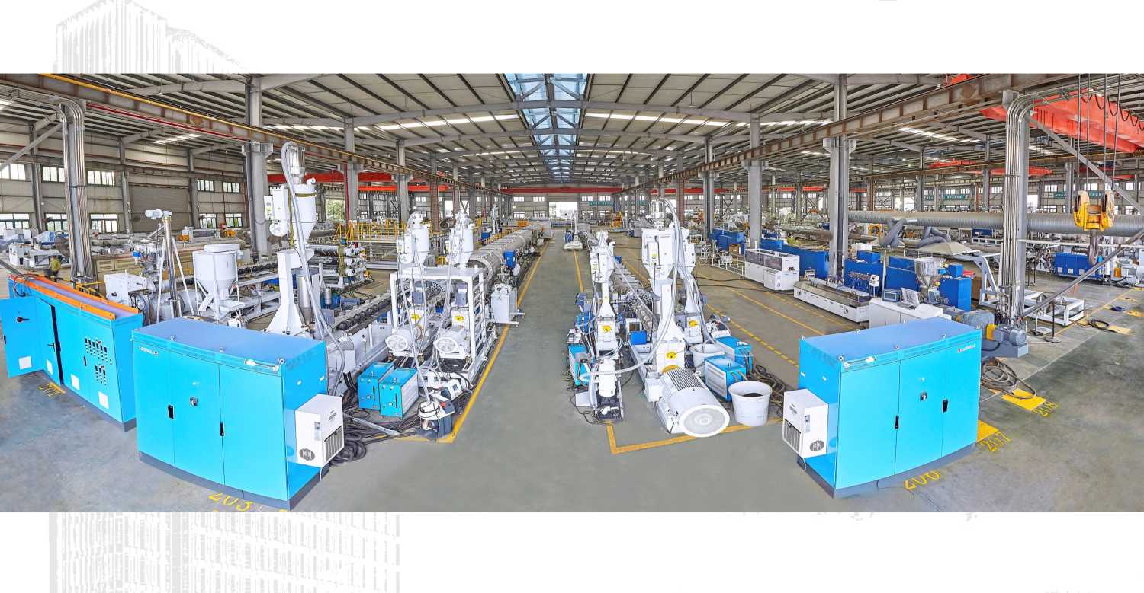
Commissioning Workshop

Slide 10
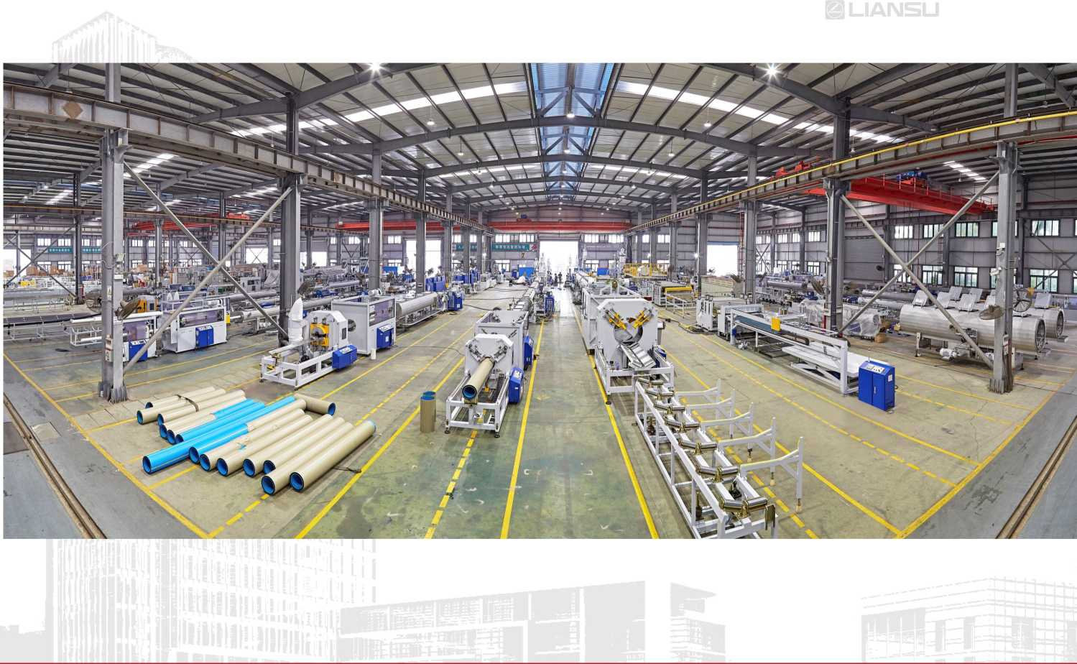
Commissioning Workshop

Slide 11
Core Products
Core Product Series
＞Plastic extrusion complete equipment
＞ Fully automatic mixing and conveying system solution
＞Supporting auxiliary equipment for plastic product production
＞Customized permanent magnet motors

Slide 12
Core Products-Plastic extrusion equipment
We provide comprehensive solutions for various types of plastic extrusion production:
A complete set of production equipment for 20~1600mm single-layer or multi-layer co-extruded plastic pipes;
Plastic powder/granules mixing& conveying mechanism and fully automatic mixing & conveying system;
Data collection and analysis system for plastic extrusion production workshop;
Fully automatic online packaging mechanism for extruding downstream;
Energy saving renovation of plastic extrusion equipment;

Slide 13
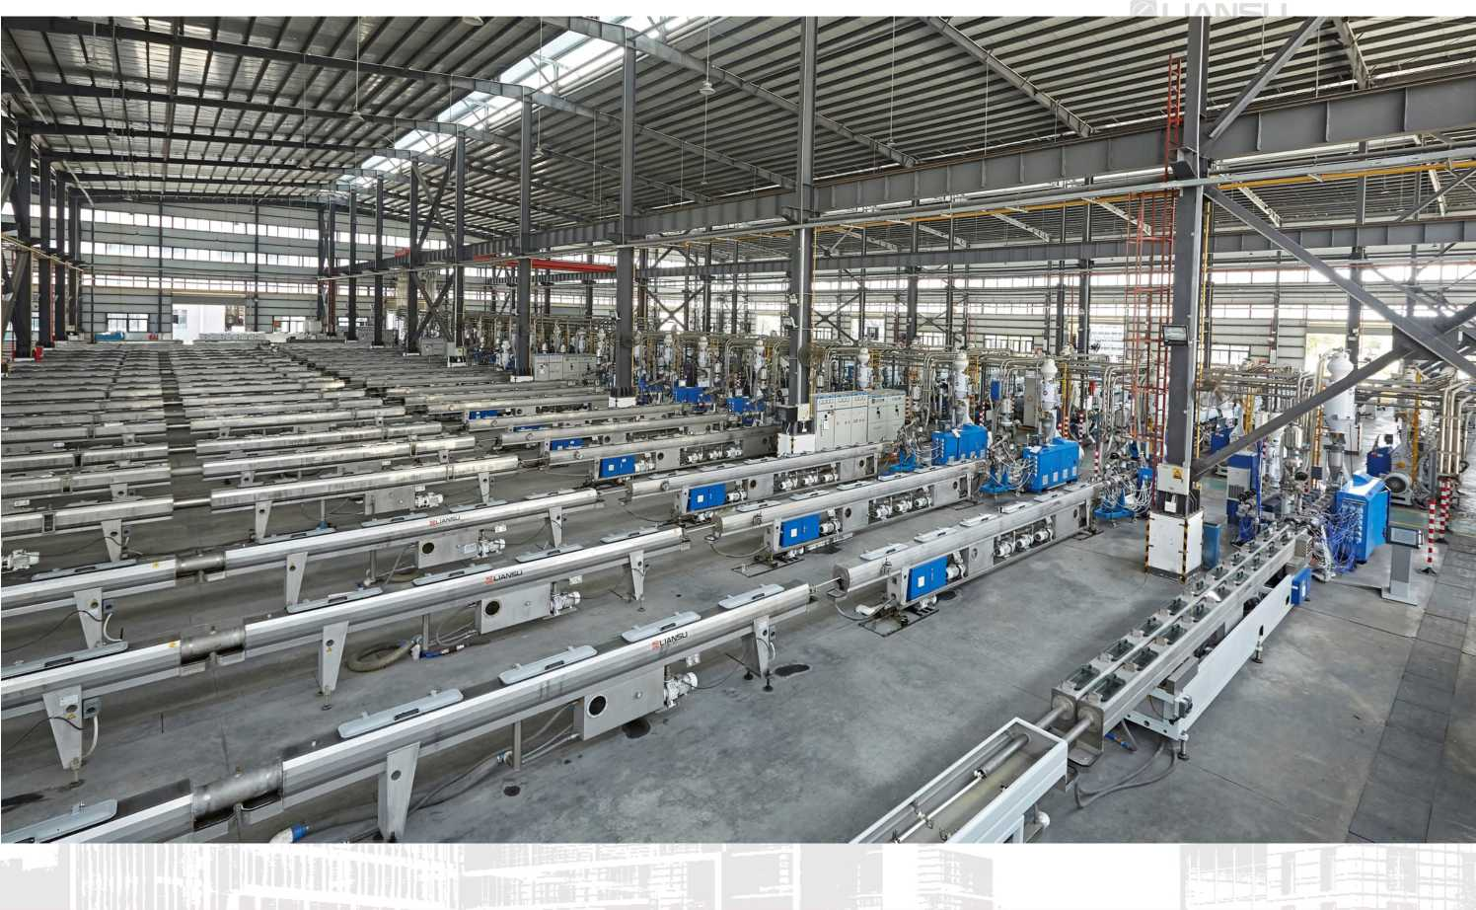
Plastic pipeline extrusion equipment

Slide 14
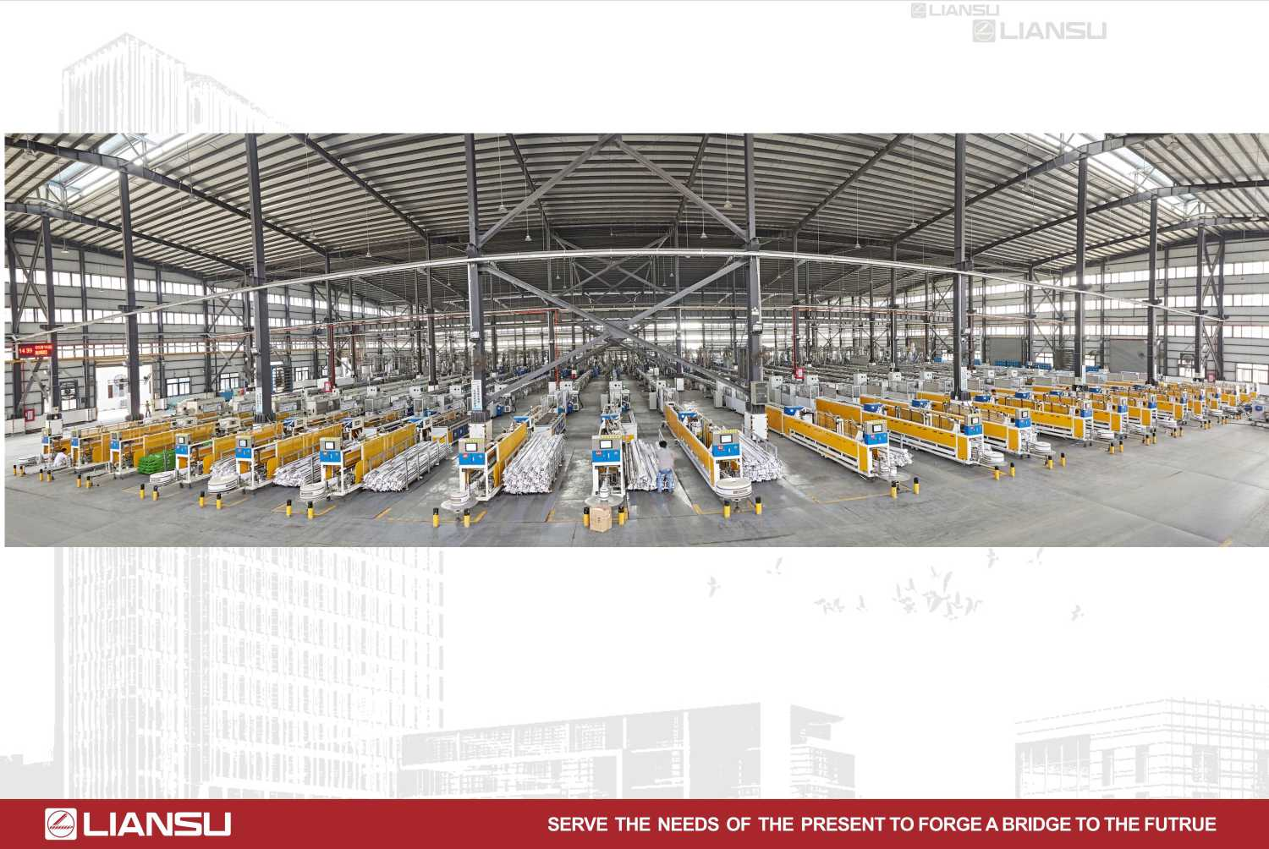
Plastic pipeline extrusion equipment

Slide 15
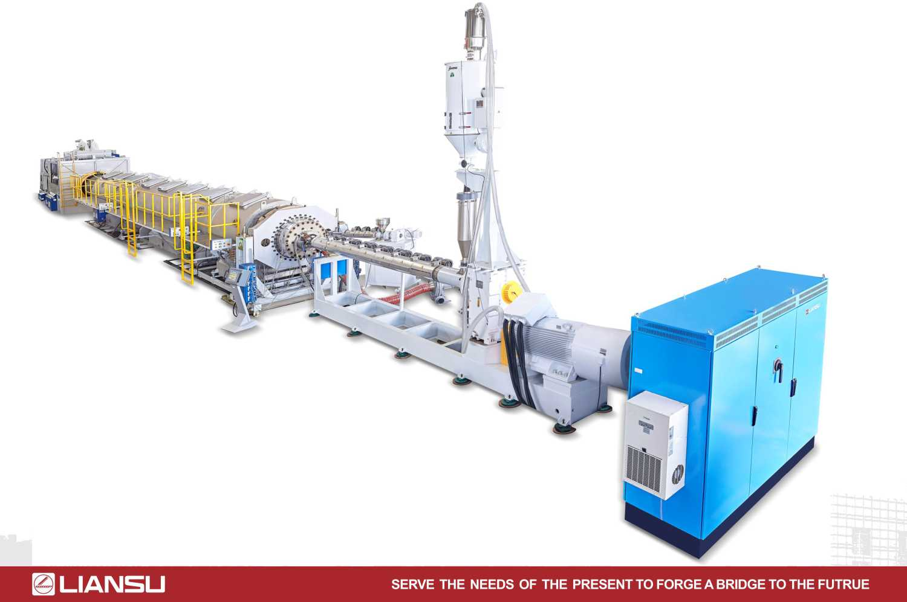
产品优势介绍--全自动供料系统
Plastic pipeline extrusion equipment

Slide 16
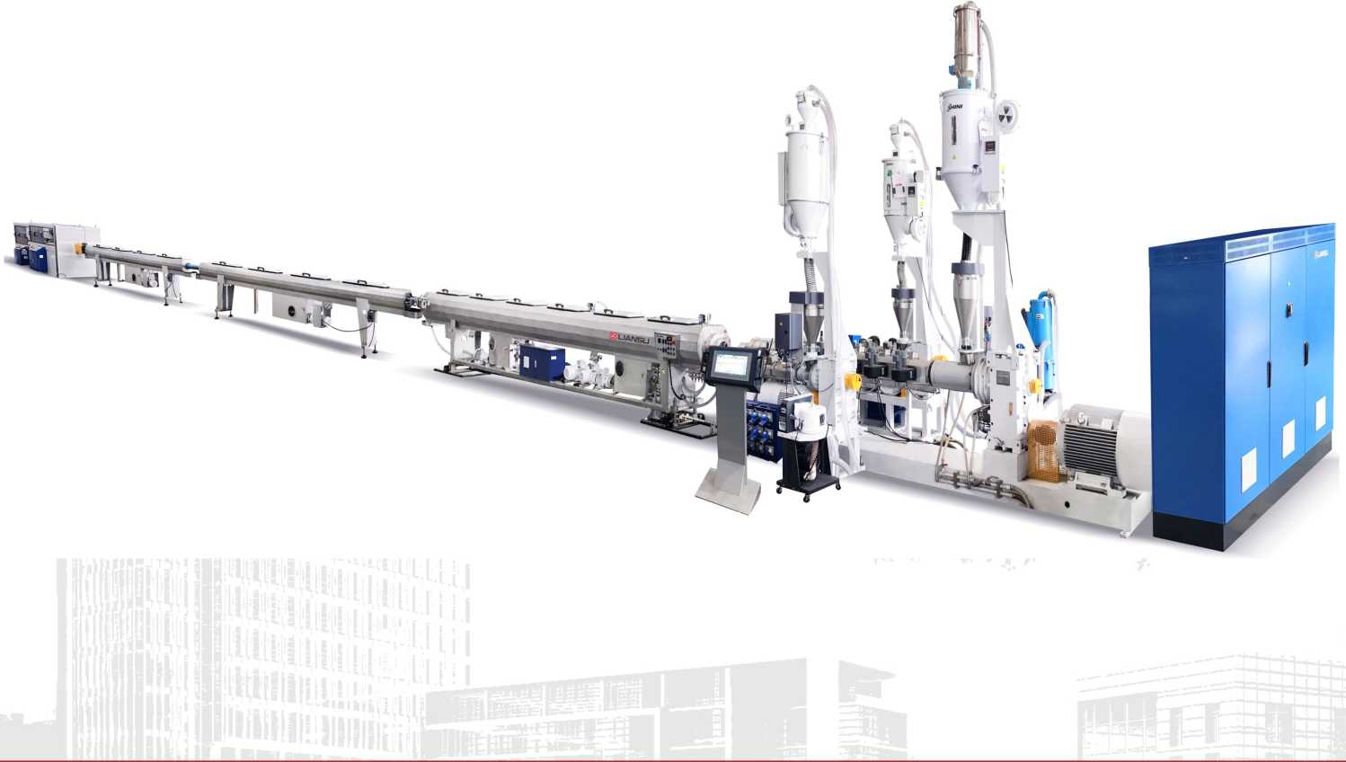
产品优势介绍--全自动供料系统
Plastic pipeline extrusion equipment

Slide 17
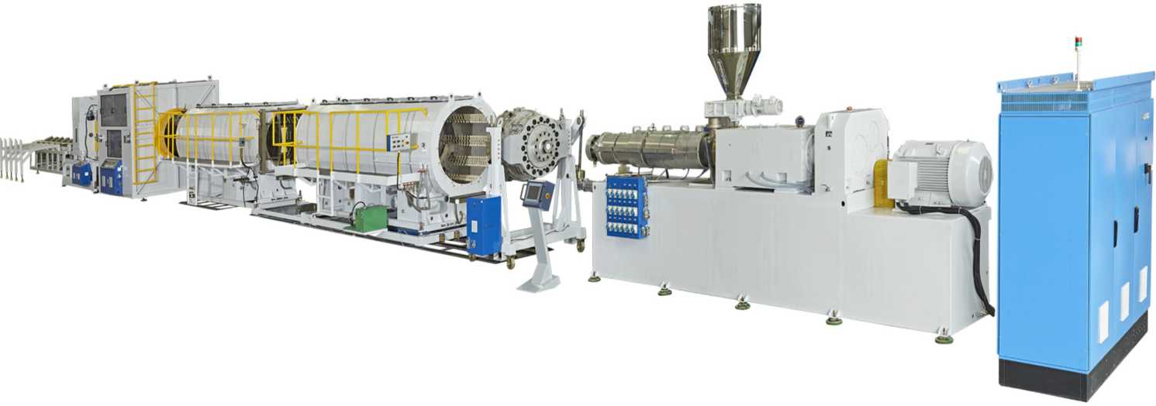
产品优势介绍--全自动供料系统
Plastic pipeline extrusion equipment

Slide 18
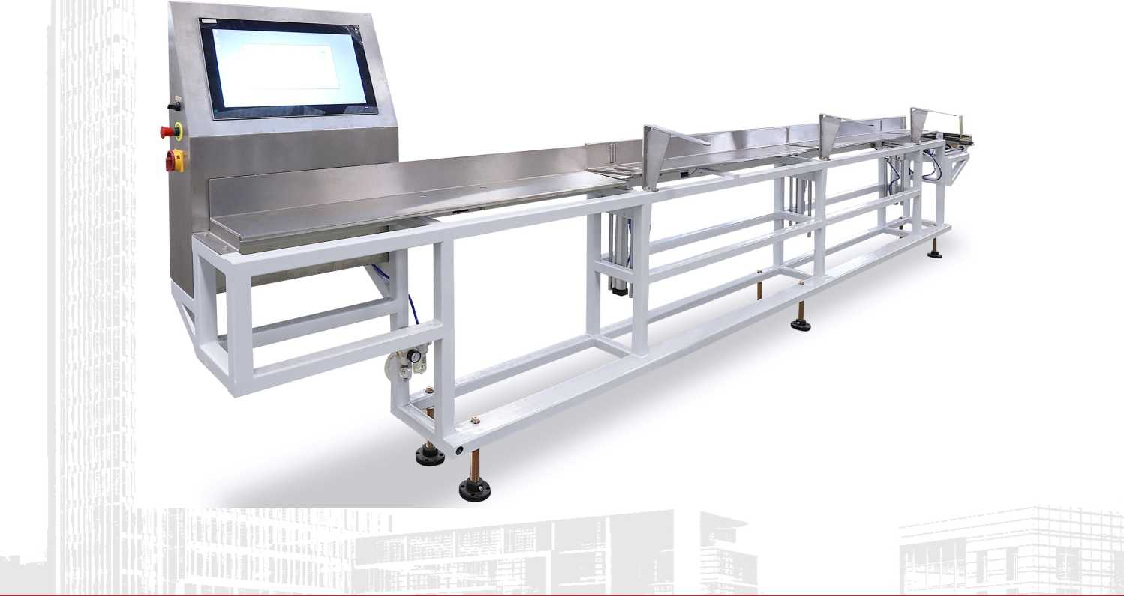
产品优势介绍--全自动供料系统
Auxiliary equipment for plastic pipeline production

Slide 19
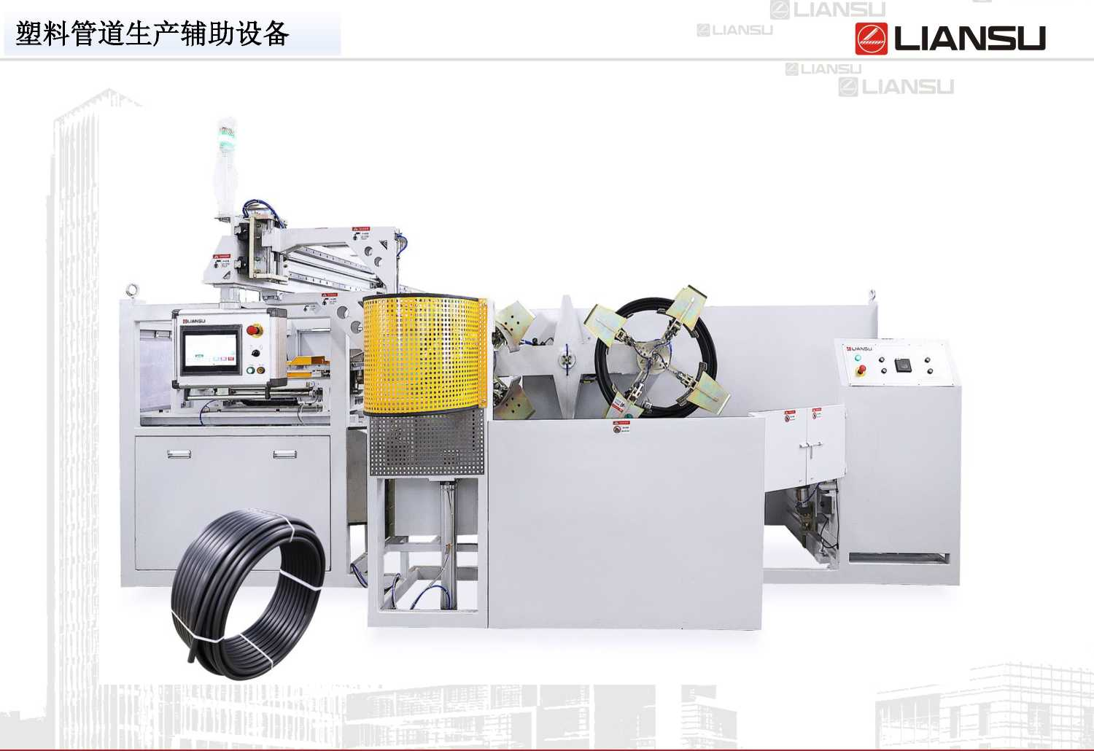
产品优势介绍--全自动供料系统
Plastic pipeline extrusion equipment
Auxiliary equipment for plastic pipeline production

Slide 20
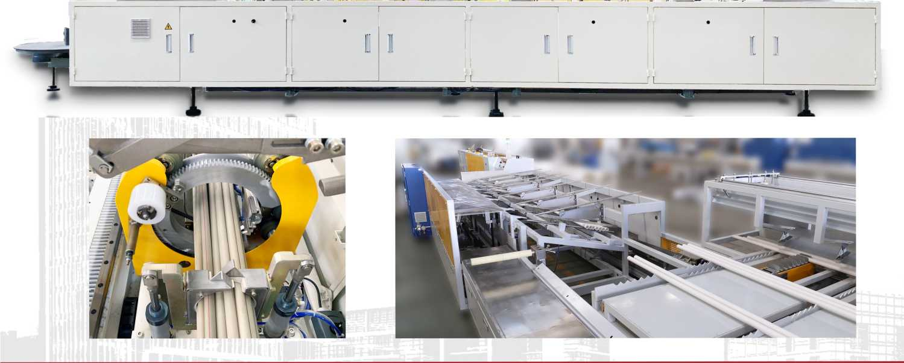
Auxiliary equipment for plastic pipeline production

Slide 21
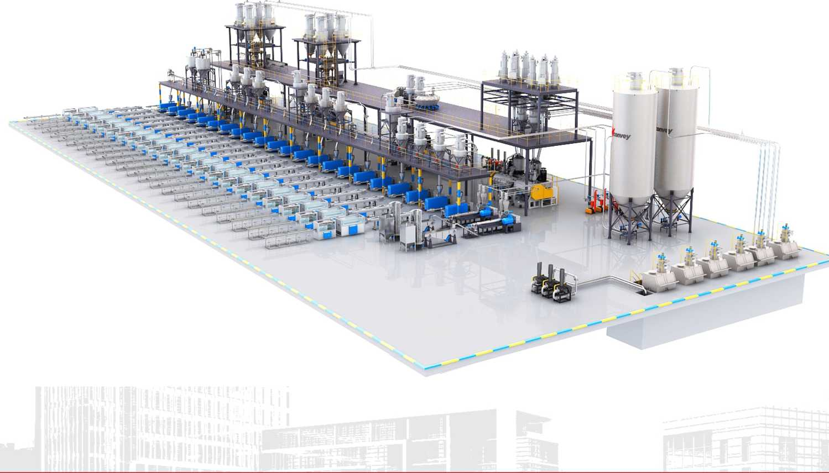
Core product - fully automatic mixing and conveying system

Slide 22
Fully automatic mixing and conveying system
＞Since 2012, Liansu has been focusing on the complete system of R&D, sales, production, installation, and service in the field of material conveying automation. So far, it has completed over 200 customized projects for domestic and foreign customers, including 100 powder material conveying systems and more than 100 granular material conveying systems, covering over 3000 sets of production equipment. The system serves fields such as plastic building materials products, modified plastics industry, coating industry, etc.
＞The material conveying system includes the entire process from raw material storage, material conveying, weighing, mixing, and automatic distribution to the production of each machine. The system control integrates data analysis modules to real-time understand multi-dimensional data analysis such as equipment utilization, material consumption, energy consumption, production capacity, and equipment maintenance, providing basic data for users' digital management.

Slide 23
Fully automatic mixing and conveying system
＞In addition to providing a complete set of customized material feeding solutions, we have simultaneously invested in the development of a series of main auxiliary equipment used in the system, such as high-speed mixing units, multi-component gravimetric mixers, online loss-in-weight color mixing machines, dehumidification dryers, positive pressure weighing and measuring feeders and negative pressure weighing and measuring feeders for pneumatic conveying, which can better control the quality and operational performance of various equipment in the system to ensure the stability of the system.

Slide 24
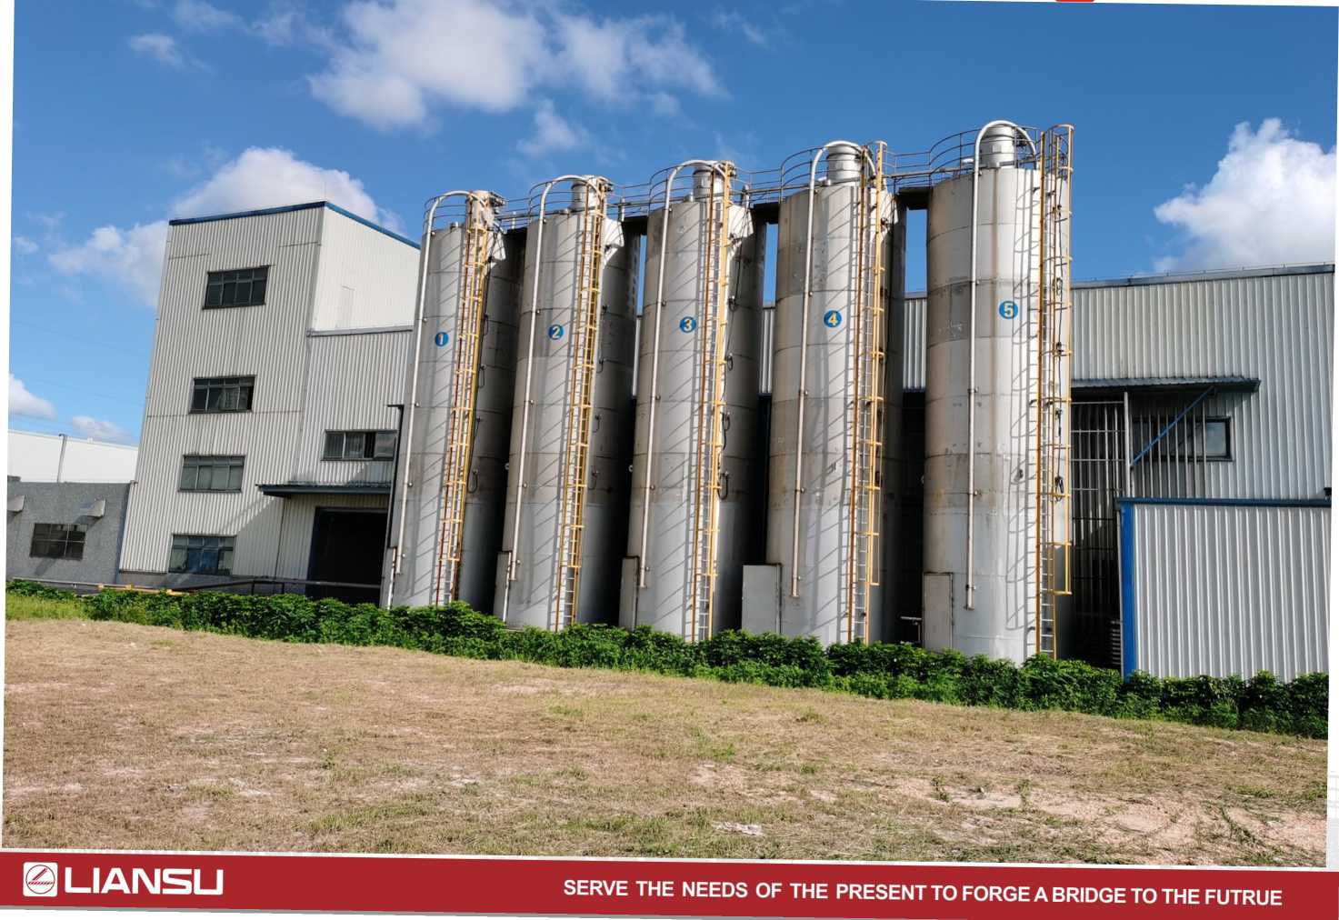
Fully automatic mixing and conveying system

Slide 25
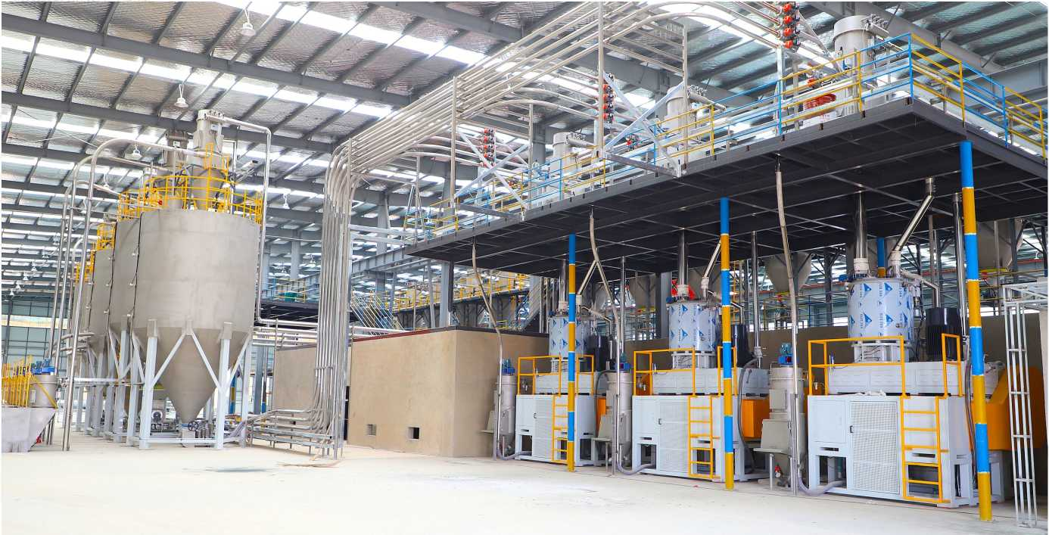
Fully automatic mixing and conveying system

Slide 26
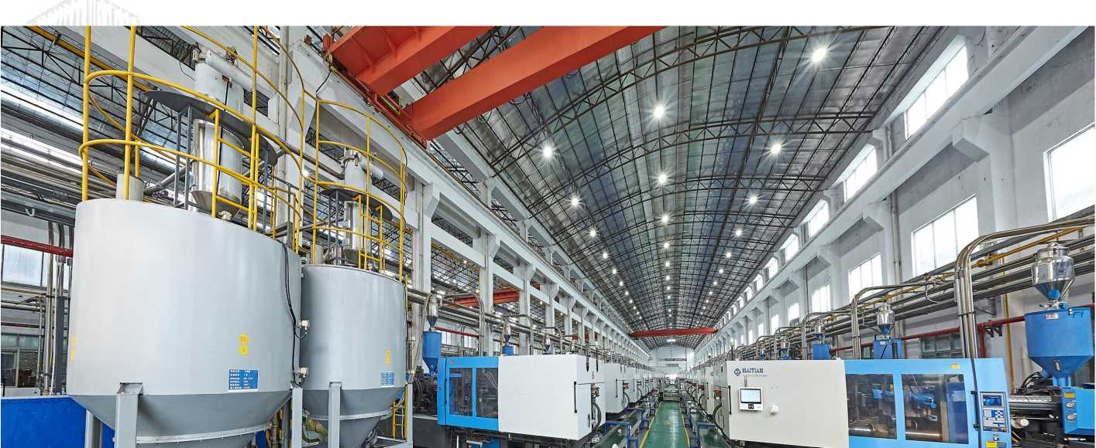
Fully automatic mixing and conveying system

Slide 27
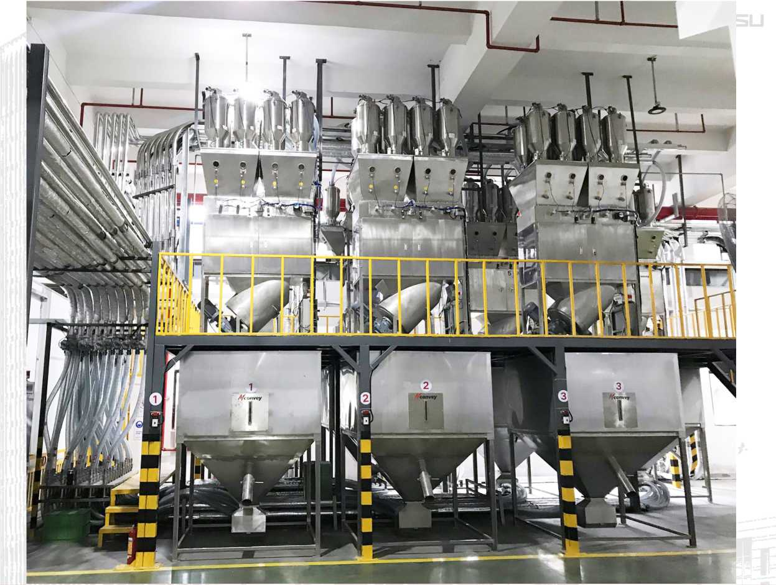
Fully automatic mixing and conveying system

Slide 28
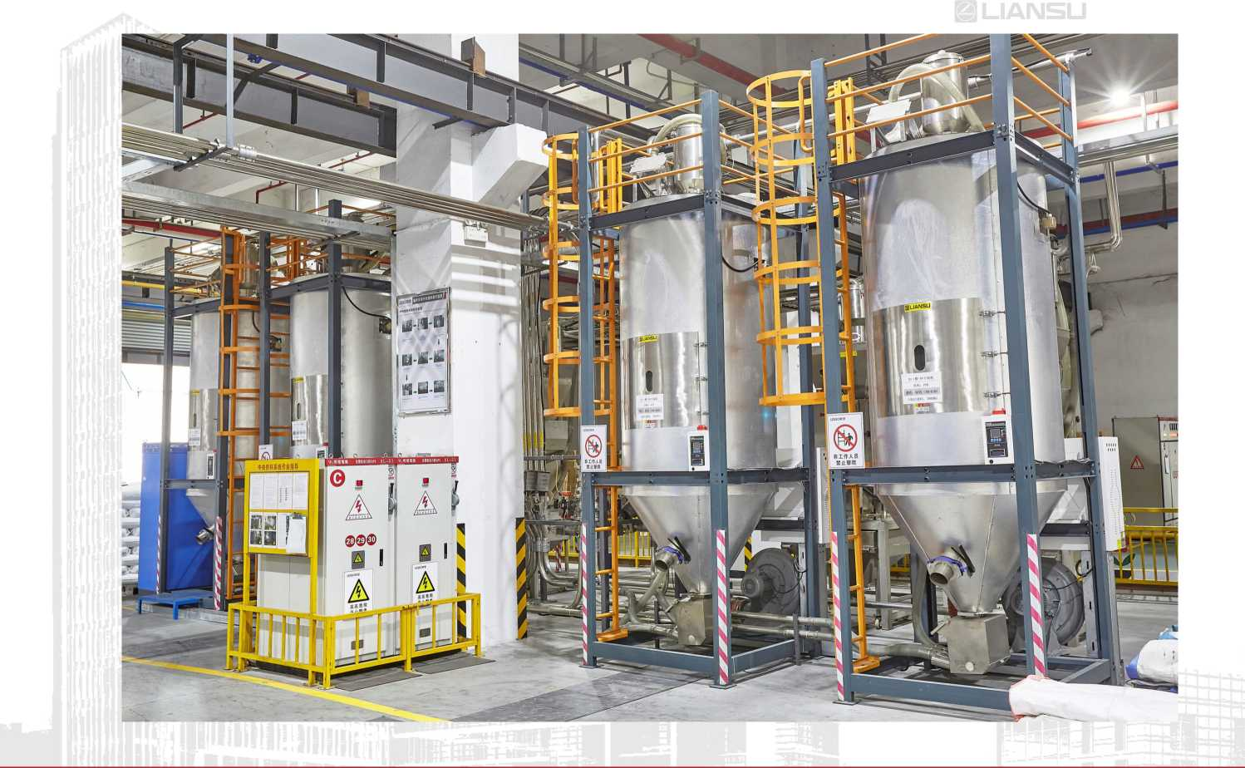
Fully automatic mixing and conveying system

Slide 29
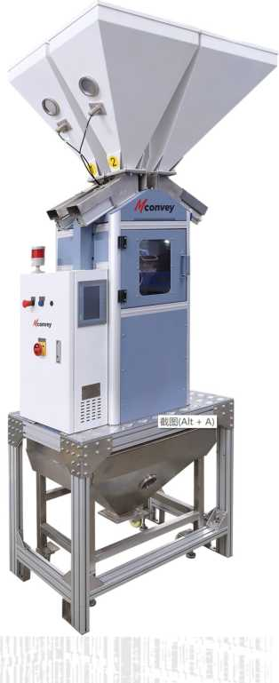
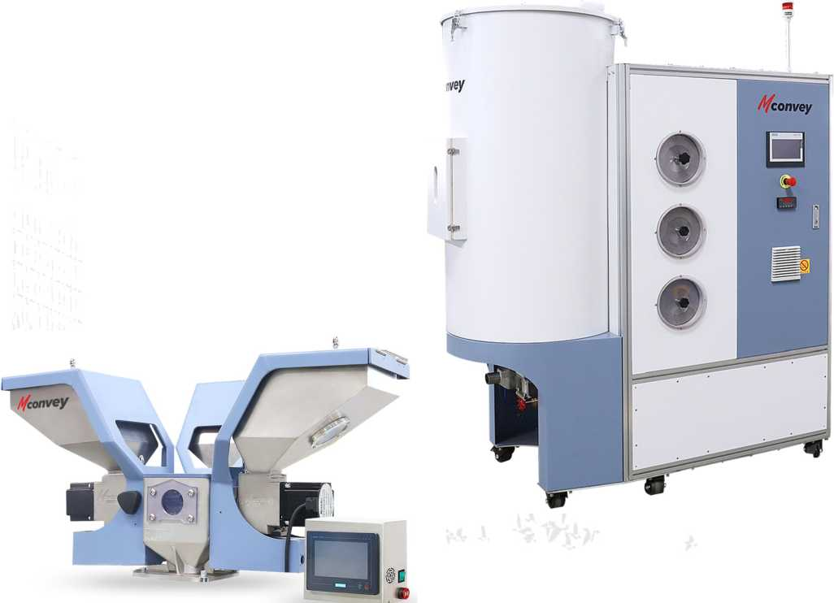
Supporting auxiliary equipment series

Slide 30
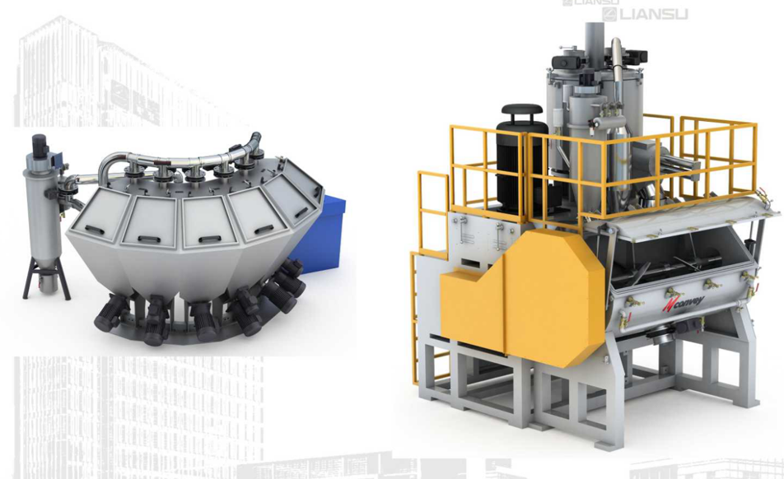
Supporting auxiliary equipment series

Slide 31
Core product - Customized permanent magnet motors
＞Since 2008, Liansu Machinery has been focusing in the R&D of customized permanent magnet motor series, providing corresponding energy-saving renovation projects in industries such as plastic extrusion equipment, ceramic equipment, and logistics transportation.
＞The current serialization of permanent magnet servo level motors covers a large span power level range of 0.75kw-400kw.
＞Our advantage in customized permanent magnet motors is to flexibly adapt to the characteristics and usage scenarios of different industries, integrate our company's production and processing advantages, and quickly carry out customized design and production to better meet the special process requirements of different industries.

Slide 32
Core product - Customized permanent magnet motors

Slide 33
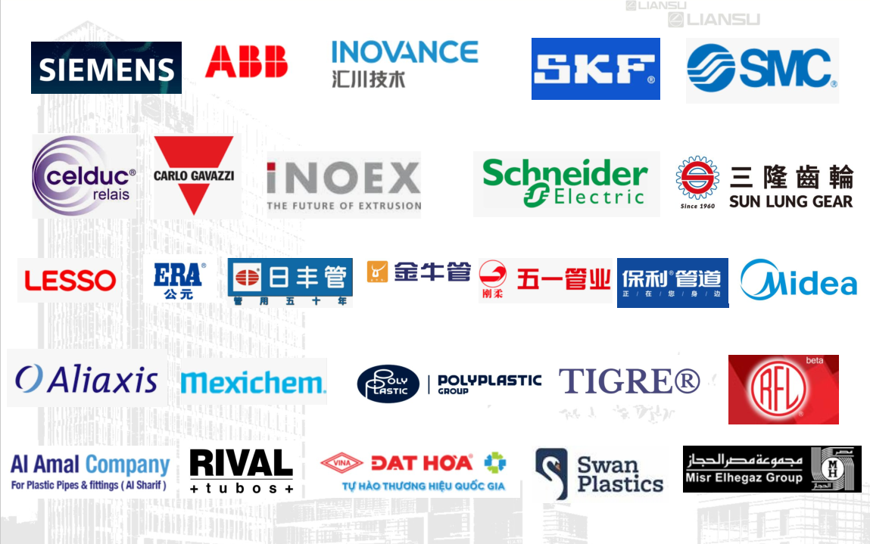
Major global partners

